Slide 1
MS BOT Framework
Key Diagram

Slide 2
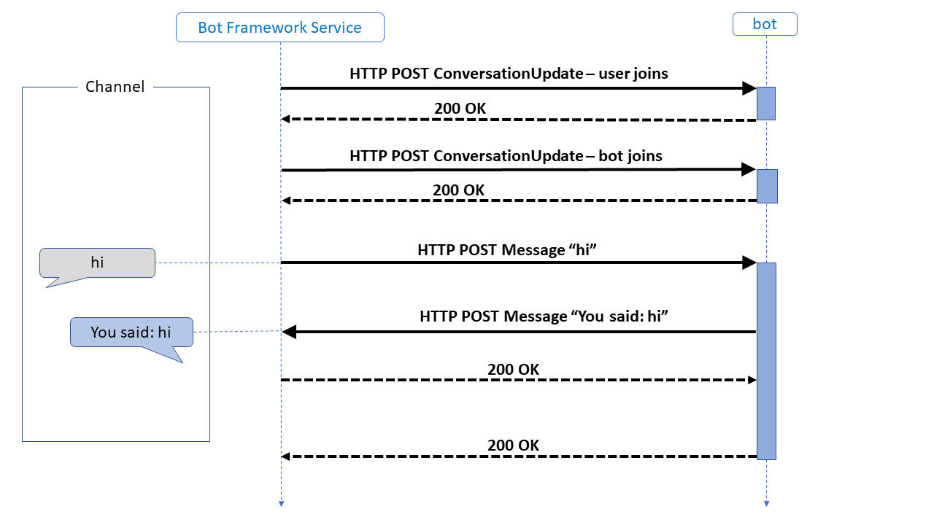
How BOT Works

Slide 3
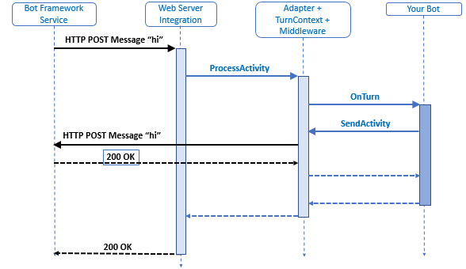
How BOT Works – Drill down Version

Slide 4
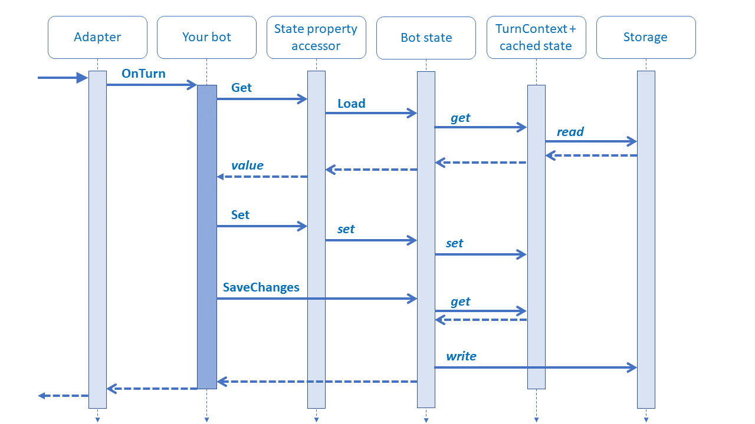
Managing state

Slide 5
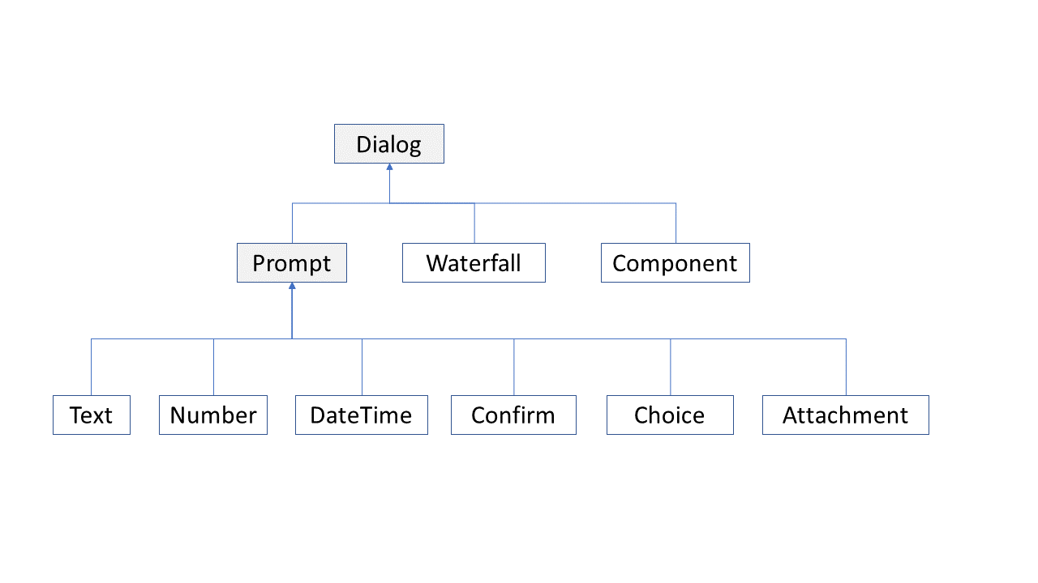
Dialog Types

Slide 6
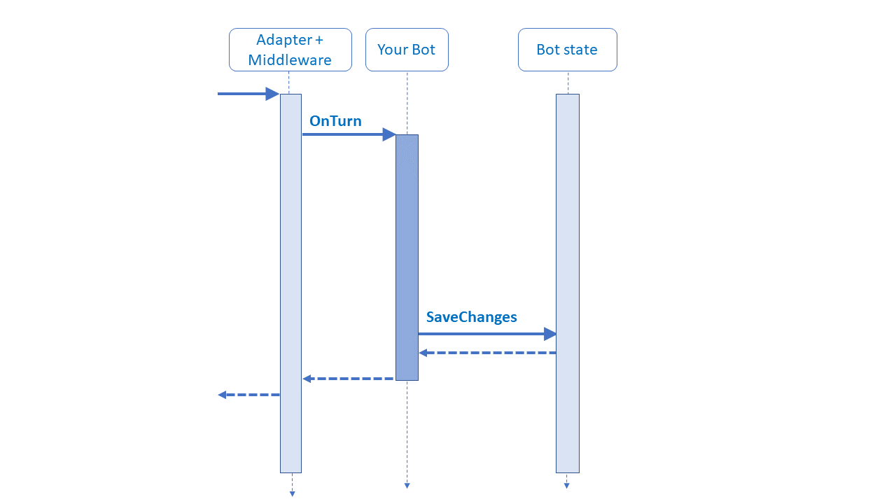
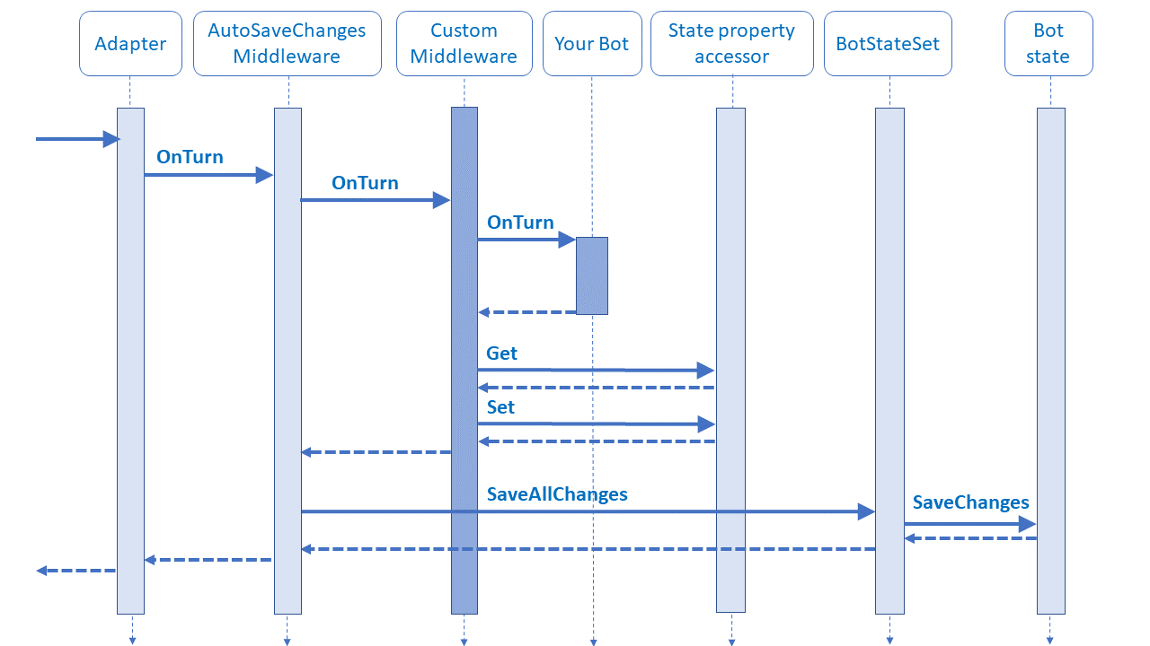
Handling Middleware

